Slide 1






Git & GitHub n00bs

Slide 2



$ WHOAMI!
Yaseer Elsnbary
Comoputer Science Student FCIS MU
Cyber Security Enthusiast & Penetration Tester wannabe.
PR Member @cisteam15
Leader Cyber Security Circle @CatReloaded & @cisteam15
Contacts:
    @YasserElsnbary2

Slide 3






Starting Point
What is git?
What is GitHub?
How git work?
Agenda
Download Git:
https://bit.ly/3f4PmmQ
create GitHub Account
www.github.com
What is version control?
Another control systems
remote repositories
Demos
references
Git Workflow
Terms
How to create a repo
markdown Language

Slide 4

01
Starting Point

Slide 5
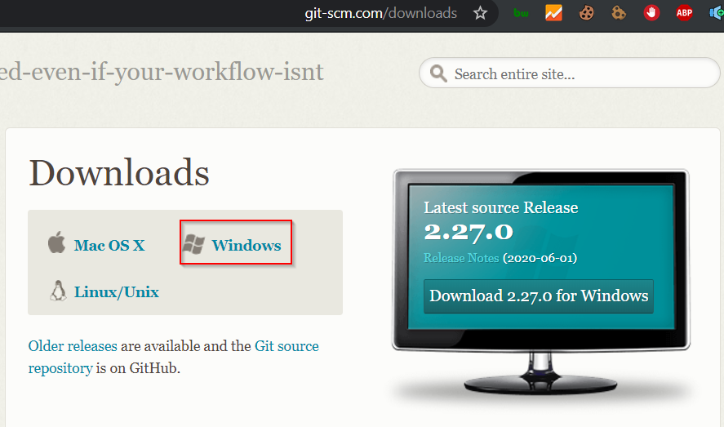
Choose You OS

Slide 6
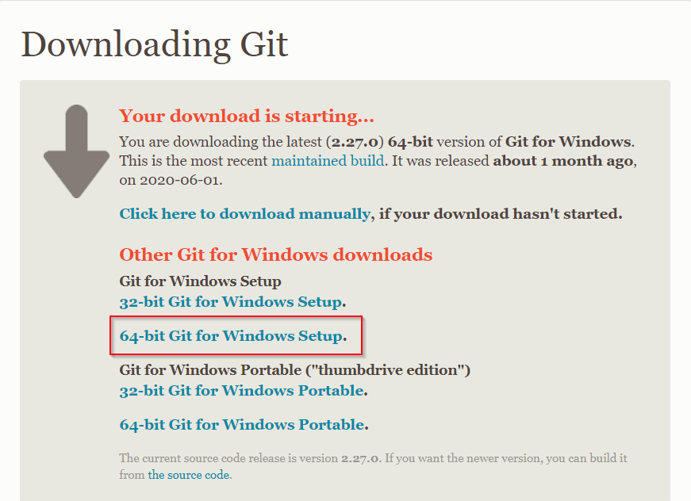
32-bit | 64-bit

Slide 7
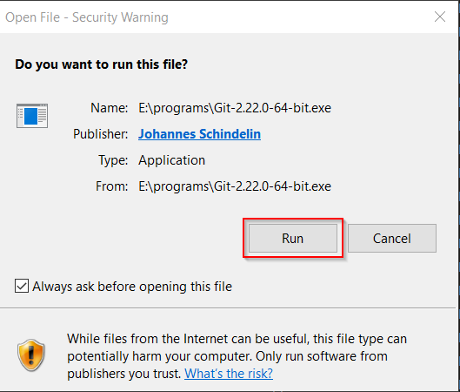
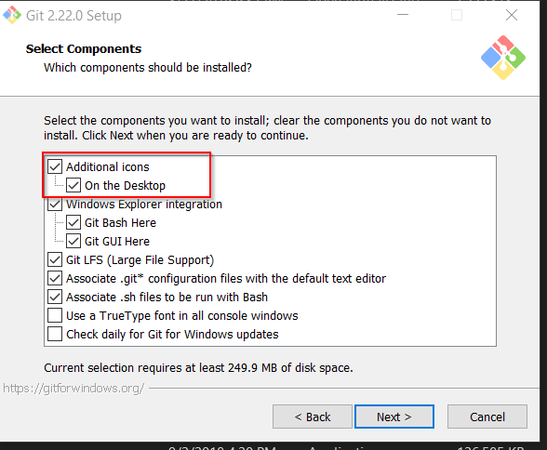
Choose You OS

Slide 8
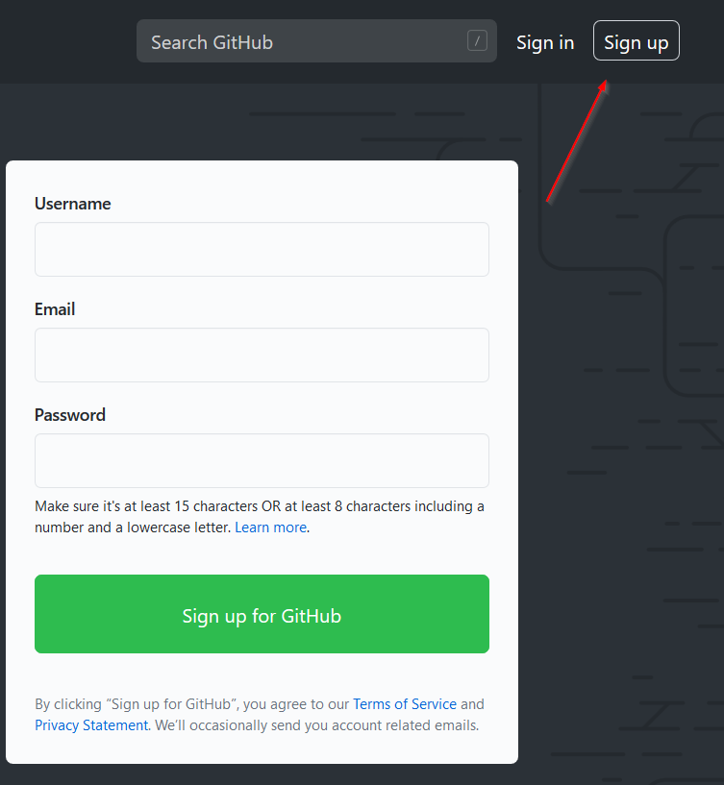
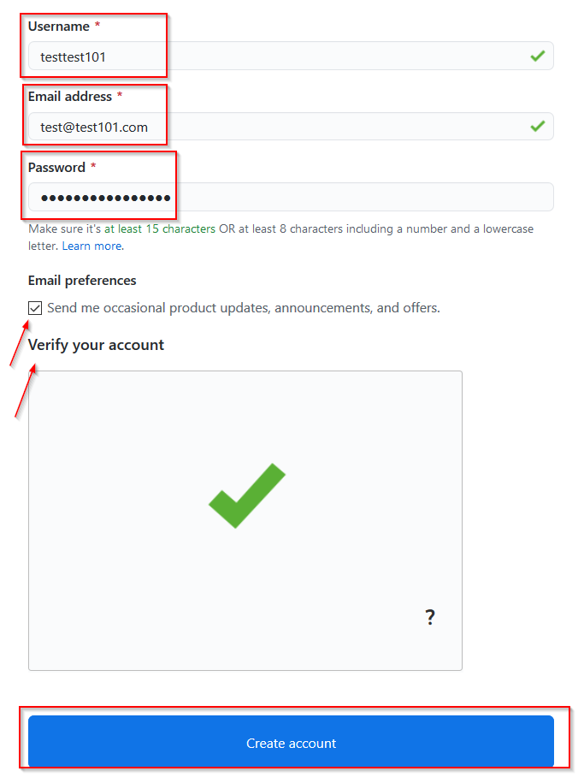
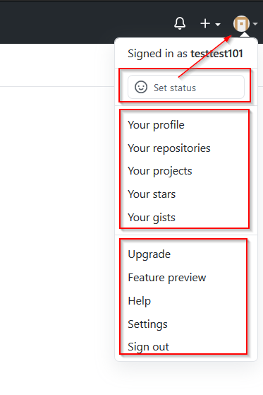
Creating GitHub Account

Slide 9

02
What Is Git ?

Slide 10

What is Git
Git is a version control system
  version Control is a system that records changes to a file or set of files and helps us recall specific versions later if needed using command line.
it allow you to:
  Revert files or the whole project to an earlier state
  Compare changes over time
  See who modified what?
  Control modifications by collaborators with the permission of admin/owners
  Merge files rather than a “lock and checkout” model
  Non-linear branching model

Slide 11
History of Git
Started in 2005
Created by Linus Torvalds to aid
in Linux kernel development

Slide 12
Another Version Control Systems
Subversion
https://subversion.apache.org/
Perforce
https://www.perforce.com/
Mercurial
https://www.mercurial-scm.org/
Codeville
http://freshmeat.sourceforge.net/projects/codeville
ArX
http://discovery.nifty.works/about/doxv1r4x42PrWnG3/arx

Slide 13

03
What is GitHub?

Slide 14
https://github.com
Founded in 2008.
Largest web-based git repository hosting service as remote repositories.
Social web, leads to social coding.
repository hosting service for Git.
Can also be used for resource sharing and management in any team/environment.
Non-linear branching model.

Slide 15


Another repository management platforms
Github
Bitbucket
Gitlab

Slide 16
04
How git work?

Slide 17
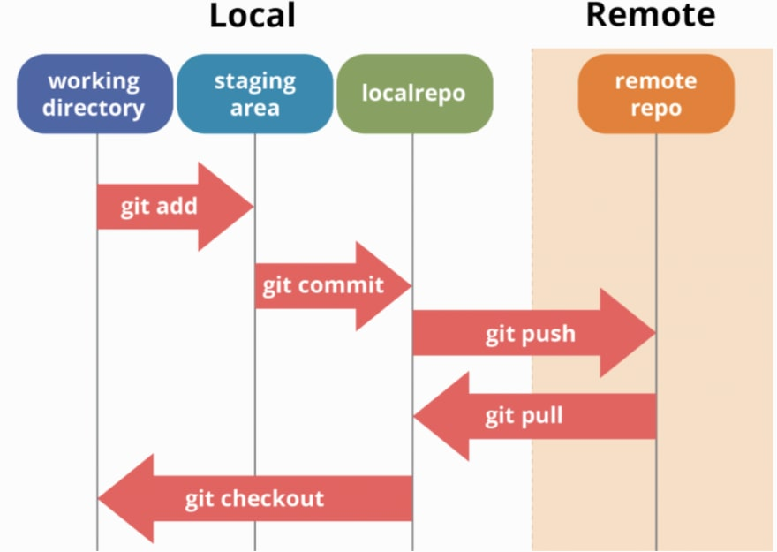
Git Workflow

Slide 18

Repositories
aka repo
Commit
cloning
Point in time snapshot of repository with changes
Collection of stored code
The act of copying a repository from a remote server

Slide 19
pushing
pulling
Pull Request
The process of adding your local changes to the remote repository
The process of downloading commits that don’t exist on your machine from a remote repository
Comparison of edits to see if team wants to accept changes

Slide 20
Fork
Branches
master
Copy repository
The main branch in a project
Indicator of divergence from base

Slide 21
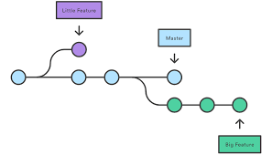
Branches process

Slide 22
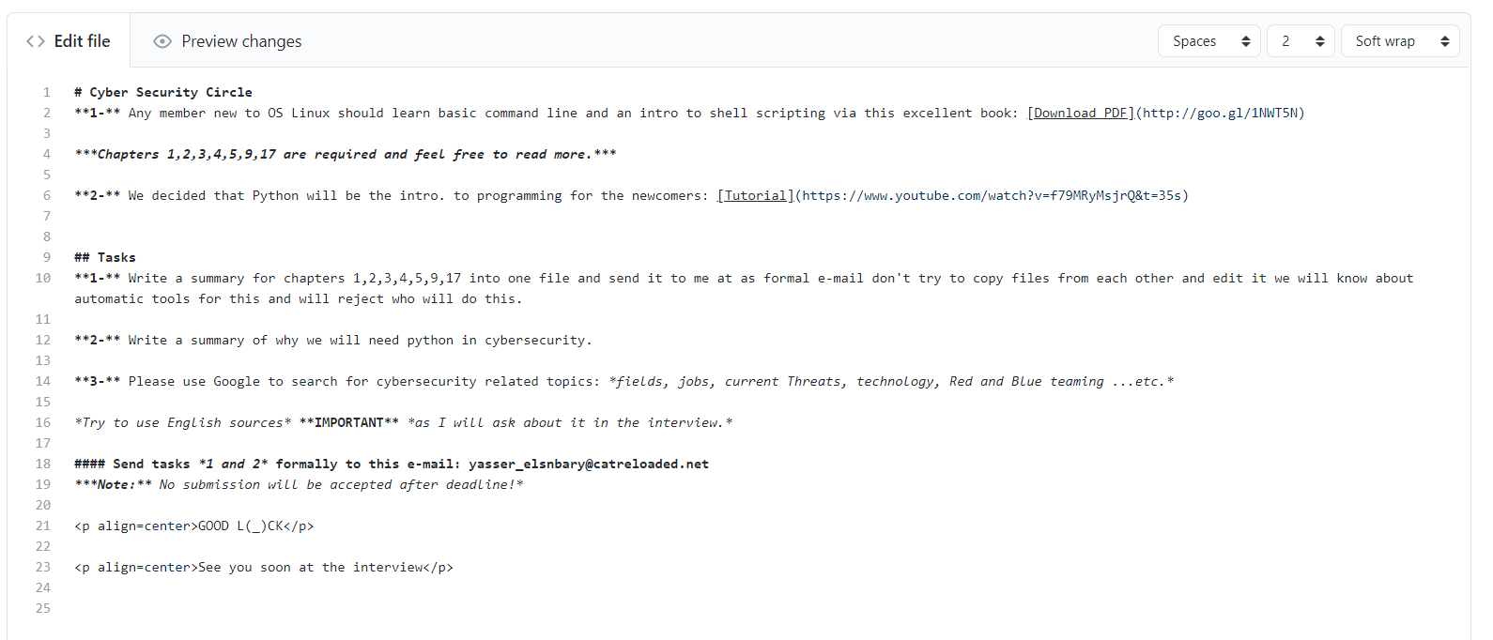
Markdown language

Slide 23
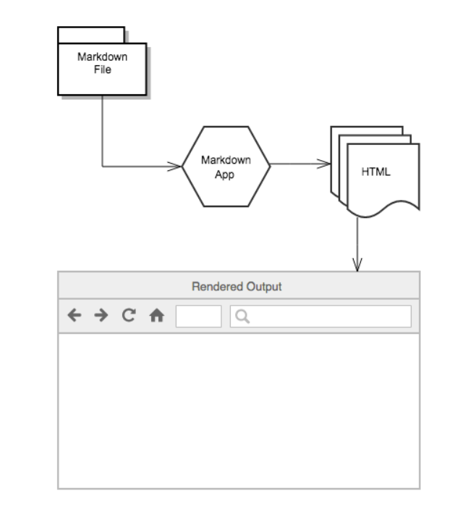
Markdown language

Slide 24

05
Demos

Slide 25
Try with yourself:
- create a repo
- clone From any repo
- Fork any repo
- create another account and make a pull Request
- try all options
- Delete repo

Slide 26

?

Slide 27
Referances
Git & GitHub crash course: https://bit.ly/2NX6U8L
What is Github: https://bit.ly/31NK0Zo
GitHub Workflow: https://bit.ly/2ZICqN5 & https://bit.ly/38yVwZX
Markup down language: https://bit.ly/2ZF8hhG

Slide 28


THANKS!

